Slide 1
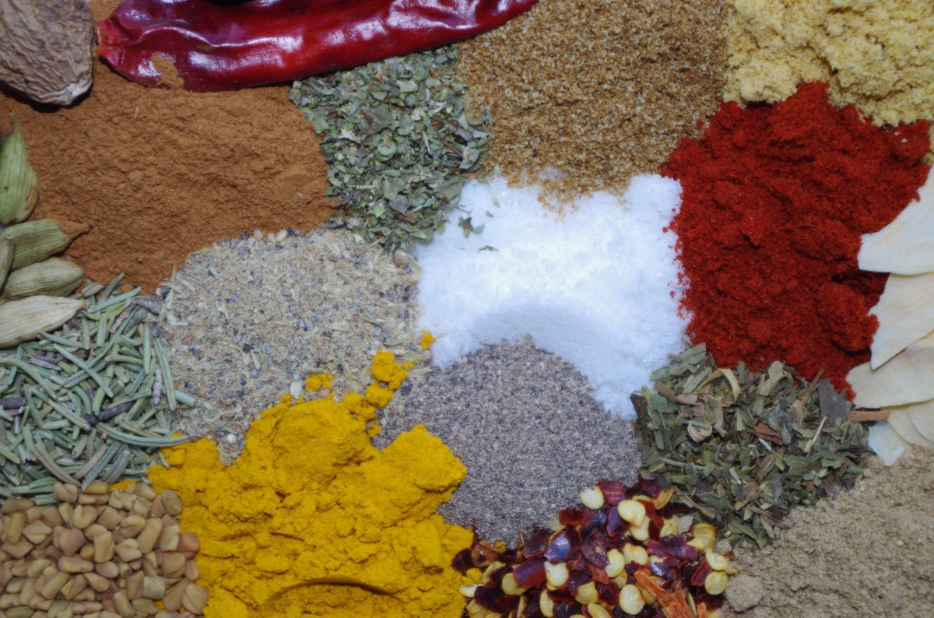
P1: Significant Significant Properties
When you
prepare a meal
you need to be aware of
ingredients
most of us find essential
for most kitchen pantries
(and ingredients for special recipes and guests).
Everybody knows essential ingredients
like salt, pepper, paprika, etc.
P1
When you
preserve information
you need to be aware of
properties
most of us find significant
in most preservation plans
(and properties for special contexts and stakeholders).
But what are they?
Significant significant properties:
“Those properties of information types that most preservation practitioners consider significant in most contexts”
To answer this question,
we collected and combined
significant properties research and practice
and created a first list
of significant significant properties…

